Slide 1
Kortere behandlingsregimer ved MDR-TB TB og Einar Heldal-dagen, FHI 7.sept 2023
Synne Jenum
Ph.D, overlege
Infeksjonsmedisinsk avdeling, Ullevål
Oslo Universitetssykehus.

Slide 2
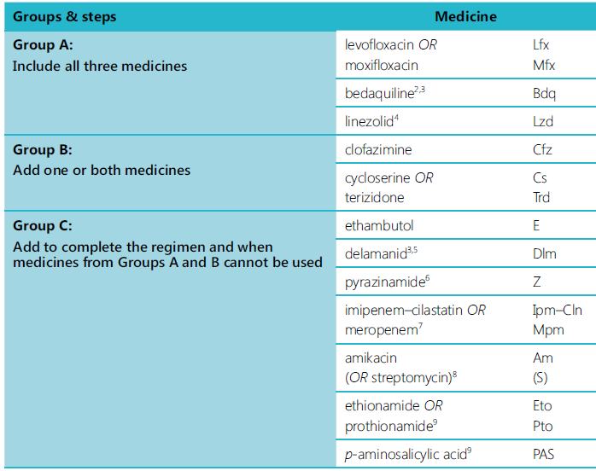
WHO 2019
Artralgi, QTc, GI, hodepine.
3 medikamenter
QTc, GI, hodepine.
Benmarg, nevropathi.
QTc, hud.
Nevropsykiatriske, hodepine, nevropathi
1-2 medikamenter
Behandle tom 12 mndr fra 1. dyrkningsneg luftveisprøve
Hørsel, nyrer
+ pyridoxin høydose
Kvalme, nevropathi.

Slide 3
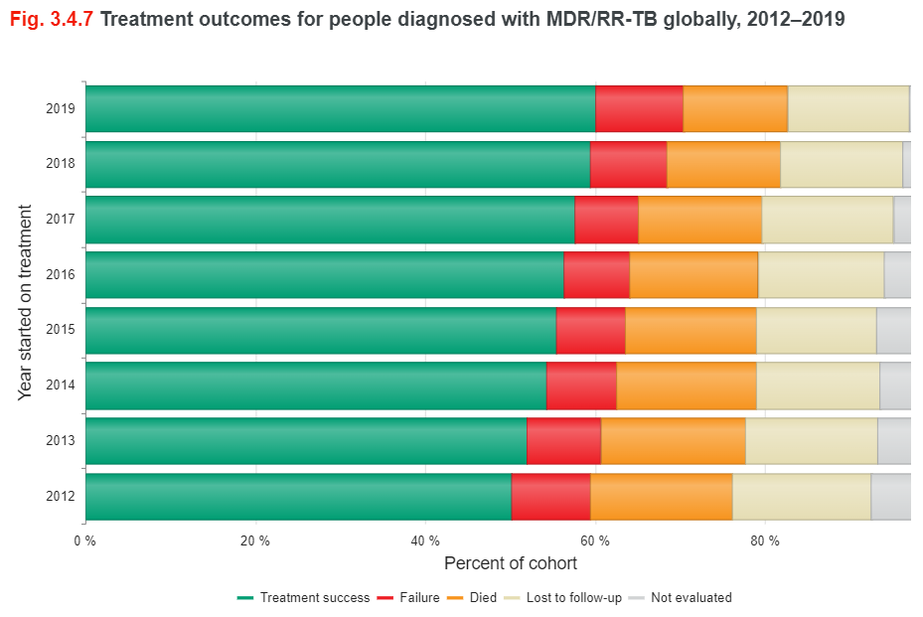
WHO. Global TB Report 2022
Treatment failure include toxicity-related drug replacement (≥2 drugs).
WHO 2013 Definitions and reporting framwork for TB ISBN 978 92 4 150534 5
Slide: Synne Jenum 07.09.23

Slide 4
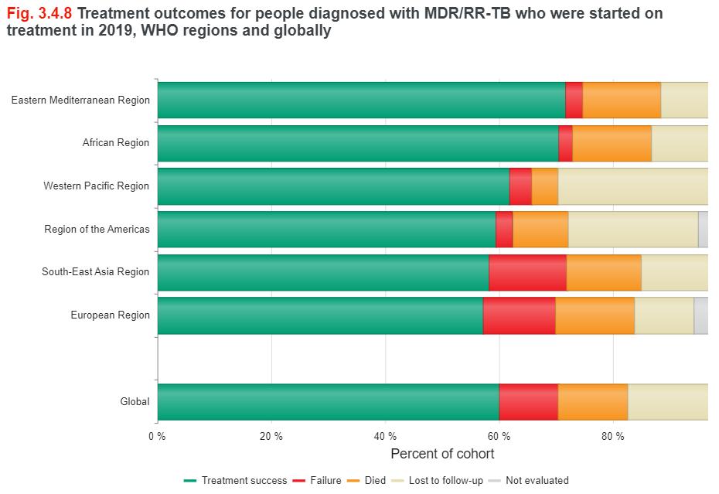
WHO. Global TB Report 2022

Slide 5
Kurativ behandling ved MDR-TB
Synne Jenum 07.09.23

Slide 6
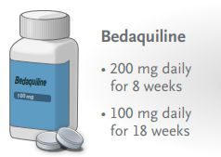
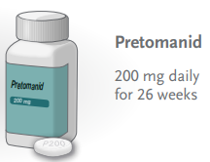
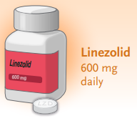
Hva er nytt?
BPaL(M) -regimet
Evt + moxifloxacin/levofloxacin
Kortere behandling
The NExT Study. Esmail A et al. AJRCCM 2022 May 15;205(10):1214-1227
TB-PRACTECAL. Nyang’wa. CROI 2022. Abstr 79
The ZeNix Trial. Conradie F et al. NEJM 2022 Sept 1;387(9):810-823
The STREAM stage 1. Goodall RL et al. Lancet 2022;400:1858-68
SimpliTB. Preliminary ECCMID 2023

Slide 7
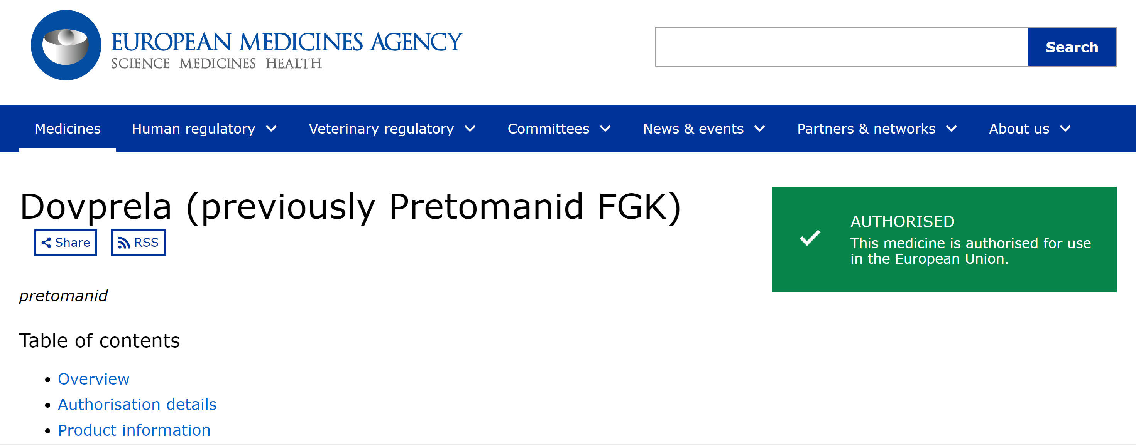
Pretomanid – nytt medikament
Aug 2020
Inhiberer syntesen av cellevegglipider (aerobt) og stimulering av iNOS (anaerobt)
Inneholder laktose.
BPaL: GI-sympt, transaminaser, nevropathi, benmargsdepr
Obs interaksjoner:
Metaboliseres via CYP3A4
Inhibierer BCRP, OATP1B3 og P-gp
Pretomanid 28 tbl a 200 mg 44 000 NOK.
Blå resept §4
Leveringstid ca 3 uker
Synne Jenum 07.09.23

Slide 8
6-month all-oral regimen for MDR-TB. (NexT) Esmail A et al., AJRCCM 2022 May 15;205(10):1214-1227.
Injectable
All-oral
Open-label RCT
South Africa
111 randomized
mITT (44:49)
per-protocol (43:44)
WHO Pre-2016. 18-20 months
Kanamycin (inj)
Moxifloxacin
Clofazimin
Pyrazimamid
Terizidone/Ethionamid/INH high-dose
NexT
Gr A - Bedaquilin
Gr A - Linezolid (600 mg)
Gr A - Levofloxacin
Gr C – Pyrazimamid
Terizidone (B)/Ethionamid (C)/ INH high-dose (C)
Dec 2014 – Sept 2016
vs
WHO Post-2016. 9-11 months
Kanamycin (inj)
Moxifloxacin/Levofloxacin
Clofazimin
Pyrazimamid
Ethambutol
Terizidone/Ethionamid/INH high-dose
Outcome at 24 m from inclusion
Dec 2016 – Sept 2018
Termination Nov 2018
According to WHO 2019 (STREAM I), BDQ included in SOC in South-Africa
Slide: Synne Jenum 07.09.23

Slide 9
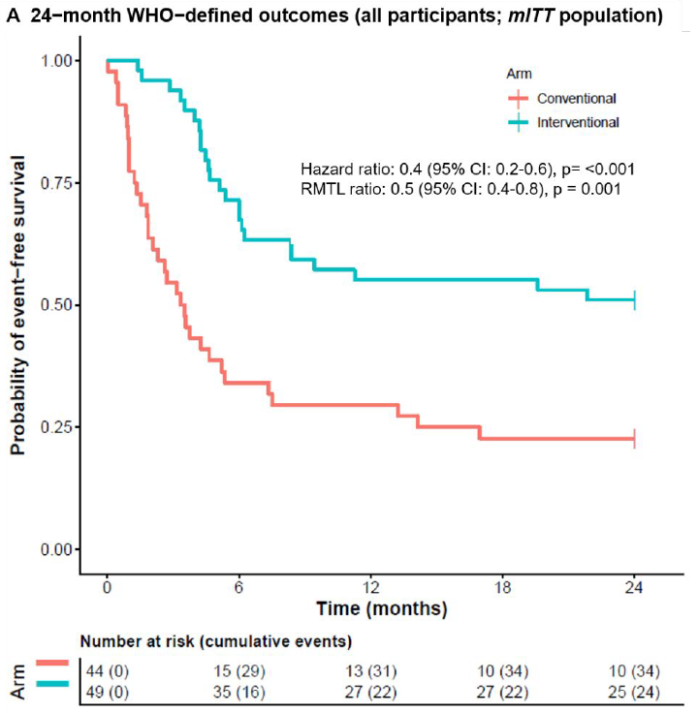
6-month all-oral regimen for MDR-TB. (NexT) Esmail A et al., AJRCCM 2022 May 15;205(10):1214-1227
67% male
50% smokers
55% HIV co-infection
52% cavitary disease
HR 0.4 (0.2, 0.6, p<0.001)
Modified Intention-To-Treat, 24 months | SOC | BDQ/LZD | RR ratio (95% CI)
WHO Favourable outcome Cured+Treatment completion AND no unfavorable outcome | 10/44 (22.7%) | 25/49 (51.0%) | 2.2 (1.2, 4.1)
Patient-centered outcome ≥12 m relapse-free cure AND no unfavorable outcome | 30/44 (68.2%) | 33/49 (67.4%) | 1.0 (0.8, 1.3)
BDQ/LZD
SOC
Slide: Synne Jenum 07.09.23

Slide 10
6-month all oral (TB-PRACTECAL) Nyang’wa. CROI 2022. Abstr 79
BPaL= Bedaquiline
Pretomanid
Linezolid
Primary Outcomes mITT n (%) | BPaL (n = 60) | BPaL + Clofazimine (n = 64) | BPaL + Moxifloxacin (n = 62) | WHO SoC 36-96 wk (n = 66)
Unfavorable outcomes Death Early discontinuation Treatment failure Lost to follow-up Recurrence | 14 (23.3) 0 8 (13.3) 0 3 (5.0) 3 (5.0) | 12 (18.8) 1 (1.6) 6 (9.4) 1 (1.6) 3 (4.7) 1 (1.6) | 7 (11.3) 0 5 (8.1) 0 2 (3.2) 0 | 32 (48.5) 2 (3.0) 28 (42.4) 0 2 (3.0) 0
P value for noninferiority | <.0001 | <.0001 | <.0001
P value for superiority | .001 | <.0001 | <.0001
Risk ratio (98.3% CI) | 0.48 (-∞ to 0.85) | 0.39 (-∞ to 0.71) | 0.23 (-∞ to 0.52)
Open-label RCT
Belarus, Uzbekistan, South Africa
23% HIV-infection
30% cavitary disease
28% FQ-resistance
SAE or new grade 3 AE | 15 (21.7) | 23 (31.9) | 14 (19.4) | 43 (58.9)
Adapted from:
Synne Jenum 07.09.23
Slide credit: clinicaloptions.com

Slide 11
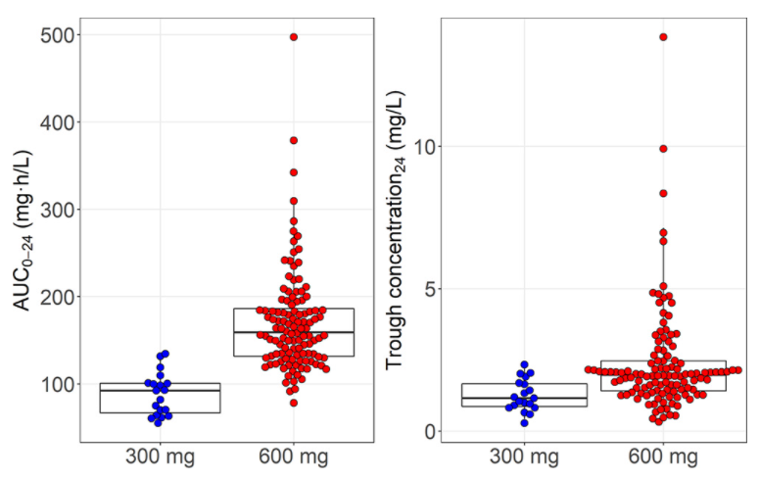
Linezolid works but at a cost!
«BPaL» 6 months Nix-TB Trial XDR/MDR (65%/17%)
Single-arm
Bedaquiline
Pretomanid
Linezolid (1200mg)
90% Cure
81% polynevropathi
48% myelosuppression
Condradie F et al., NEJM 2020;382:893-902
MIC target AUC >119
Target
<2 mg/L
Abdelwahab MT et al Antimicrob Agents Chemother. 2021;17:65(12):e0138121) 124
Slide: Synne Jenum 07.09.23

Slide 12
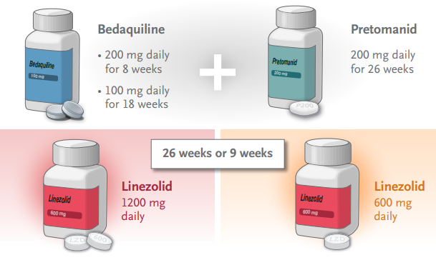
BPaL regimens for Drug-Resistant TB Conradie et al., NEJM 2022 Sept 1;387(9):810-823
67% male
36% smokers
20% HIV co-infection
62% cavitary disease
41% XDR-TB
47% pre-XDR
36% South Africa
64% Georgia, Moldova, Russia
Synne Jenum 07.09.23

Slide 13
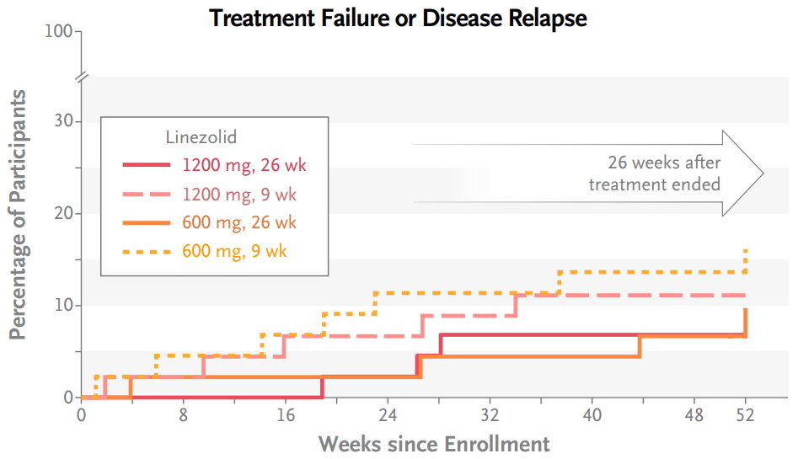
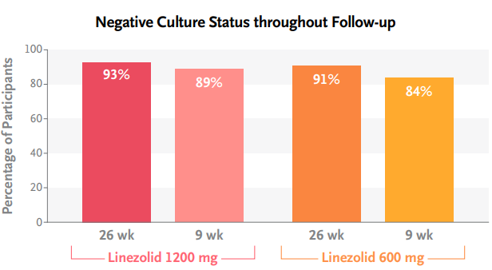
BPaL regimens for Drug-Resistant TB (ZeNix Trial) Conradie et al., NEJM 2022 Sept 1;387(9):810-823
N=45
N=46
N=45
N=45
↓dose/stop | 50% | 30% | 13% | 13%
nevropathy ≤3 | 38% | 24% | 24% | -
opticusnevritis | 9% | - | - | -
↓bonemarrow | 22% | 15% | 2% | 13%
Synne Jenum 07.09.23

Slide 14
Linezolid ikke gitt!

Slide 15
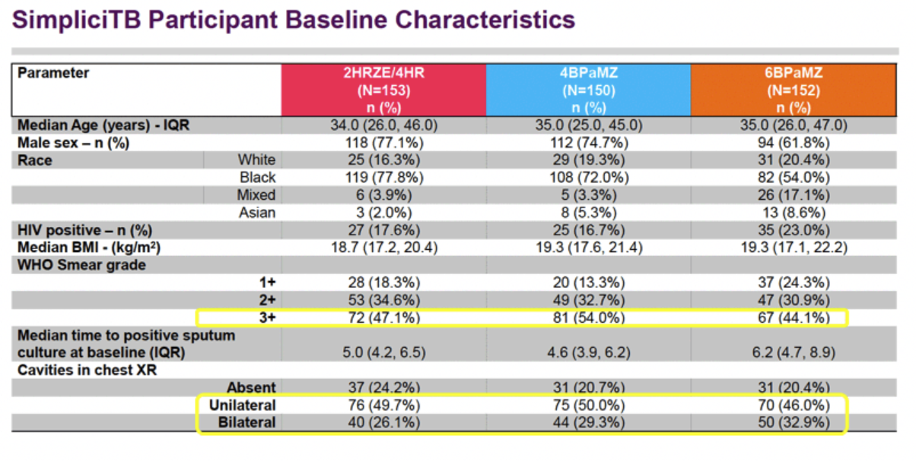
MDR-TB

Slide 17
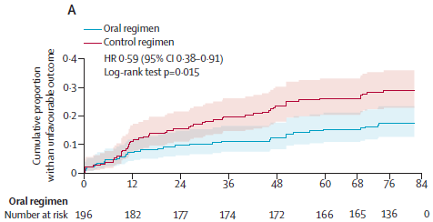
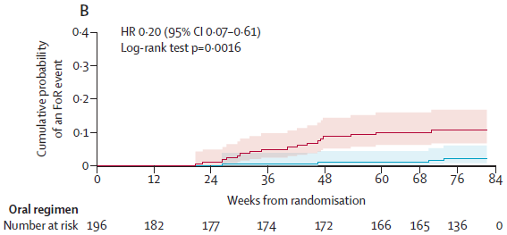
Dersom BPaL(M) IKKE kan brukes Kortere behandlingstid er OK uansett!
The NExT Study
Esmail A et al. AJRCCM 2022 May 15;205(10):1214-1227
STREAM stage 2
Goodall RL et al. Lancet 2022;400:1858-68
Synne Jenum 07.09.23

Slide 18
Smittsomhet og isolasjon ved MDR-TB
Argument for lenger isolasjonstid av MDR-TB 2 ting:
Medisinene vi har tilgjengelige er mindre effektive
Smitte har større konsekvens.
Synne Jenum 07.09.23

Slide 19
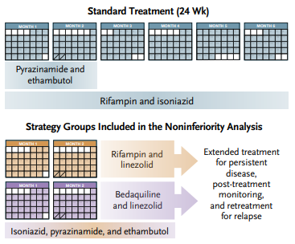
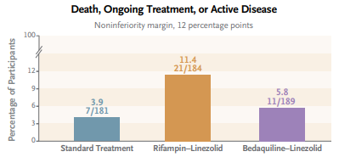
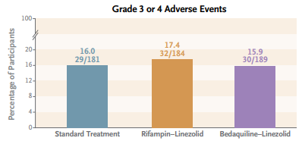
Synne Jenum 07.09.23
NEJM Paton NI et al (the TRUNCATE-TB Trial Team) 2023. DOI: 10.1056/NEJMoa2212537

Slide 20
Takk for innsatsen Einar Heldal

